Slide 1
PANEL REGRESSION
ESPECIALLY CROSS SECTIONAL -TIME SERIES MODELING
A PRIMER ON

Slide 2
WHAT ARE PANEL DATA?
Panel or longitudinal data, are data collected at different
points in time and a type of cross-sectional data, or data by some subject
1) JUST TIME SERIES DATA (time effects)
Many observations on as few as one subject, e.g., stock prices, media spend organized by time period
2) JUST POOLED CROSS SECTIONAL DATA (group effects)
Two or more independent samples of many subjects drawn from the same population at different time periods, e.g., population surveys, census surveys, customers, stores, zipcodes, etc.
3) POOLED CROSS-SECTIONAL TIME SERIES DATA (both group and time effects)
Two or more observations on many subjects, e.g., longitudinal data by customer, time series data by store, etc.
LONGITUDINAL DATA
A dataset is longitudinal if it tracks the same type of information on the same subject at multiple points in time.
For example, tracking many customer’s sales by month, tracking many stores sales by month, etc.
An advantage of panel modeling is to understand change on a subject over time

Slide 3
THE FIXED EFFECTS MODEL
A model with constant slopes but intercepts that differ by cross section and / or
by time period
PROS AND CONS
Degrees of freedom
The FE model may frequently have too many cross sectional units of observations requiring too many dummy variables for their specification
Too many dummy variables may rob the model of sufficient number of degrees of freedom for adequately powerful statistical tests
Collinearity
So many dummy variables increases the probability of collinearity which increases the standard errors, decreases statistical power and increases the likelihood of switching signs
BUT:
FE models are ideal when error terms are correlated with individual effects
thereby partitioning out unobserved heterogeneity
Y_{it} = a_{i} + X^{t}_{it}B + e_{it}.
Y_{it} is the dependent variable, by cross section i by time t, where a_{i} is the cross sectional-specific intercept terms, X is the independent variable data by time and by cross section and B is the coefficients on the independent variables.

Slide 4
THE RANDOM EFFECTS MODEL
Assumes the intercept is a random outcome variable
This random outcome is a function of the mean value plus a random error
This generates a specific random error for cross sections and for time periods
PROS
Can allow for time invariant variables
Low degrees of freedom
Y_{it} = X^{t}_{it}B + a + u_{i} + e_{it}.
Y_{it} is the dependent variable, by subject i by time t, where a + u_{i} is the unobserved effect partitioned into a component that is common to all cross sections and a disturbance that is cross sectional specific, X is the independent variable data by time and by cross section and B is the coefficients on the independent variables.
The coefficients are allowed to vary over the cross sections. This model allows both random intercept and independent variables to vary around common means. Thus the random coefficients can be considered outcomes of a common mean and an error term, representing a mean deviation for each cross section.

Slide 5
WHY ANALYZE PANEL DATA?
We are interested in describing change over time by cross-section
Panel modeling controls for effects by cross-section and effects by time period
Individual effects (either random or fixed) can be specifically modeled, both by
Cross section and by time
If binary variables are considered as part of the intercept, it is a fixed effects model
If binary variables act as an error term, it is a random effects model
Still have to be cognizant of the “dummy trap”
If there are unobserved differences, Panel / FE models can transform the differences so
as to be removed
FE models assume individual effects are constant, bu t not common across subjects
FE models trade consistency for efficiency
FE models are “within” estimators
It’s fun!
proc panel data= sasdata.finished_model_data outest = panelest;
id county QTR;
model units =
tv_lag2 drtv_lag3 dirmail_lag1 dirmail_lag2 email / fixtwo hausmann;
output out = panelout2 p = pred r = residual;
run;

Slide 6
OVERVIEW OF PANEL
(cross-sectional time series) MODELING
WHAT ARE PANEL DATA?
PANEL DATA are a type of longitudinal data, or data collected at different
points in time on the same group.
In our example, we have 8 quarters (time) of data measured on each county (group).
WHY MODEL PANEL DATA?
We are interested in describing group change over time.
We are interested in estimating some independent variable’s (e.g. media spend) impact, given changes over time, taking into account (controlling for) group differences.
WHY NOT USE ORDINARY REGRESSION?
OLS assumes each row is independent. That is certainly not the case here.
If unobserved heterogeneity is correlated with any of the independent variables, OLS will be biased and inconsistent.
NET SALES_{cq} = β₁MEDIA X_{cq} + β₂MEDIA Y_{cq} + β₃PURCH INT_{cq} +...+ β_{n}X_{cq}
That is, panel regression will estimate the impacts of media, et al, on incremental change, accounting for (controlling for) changes over time given different counties.
The major advantage of panel modeling is that a model for the structure of the errors can be designed. It is important to consider what kind of error structure model is appropriate for the data and the business problem.
COUNTY | QUARTER | CHANGE COUNT | MEDIA X | MEDIA Y | PURCH INT
1000 | 1 | 2 | $450 | $563 | 2
1000 | 2 | 4 | $125 | $150 | 2
1000 | 3 | -3 | $375 | $469 | 2
1000 | 4 | 41 | $2,500 | $3,125 | 2
1000 | 5 | 6 | $675 | $844 | 2
1000 | 6 | -4 | $188 | $234 | 2
1000 | 7 | 2 | $563 | $703 | 2
1000 | 8 | 36 | $3,750 | $4,500 | 2
1001 | 1 | 6 | $1,013 | $1,266 | 3
1001 | 2 | -12 | $281 | $352 | 3
1001 | 3 | 9 | $844 | $1,055 | 3
1001 | 4 | 123 | $5,625 | $6,000 | 3
1001 | 5 | 18 | $1,519 | $2,000 | 3
1001 | 6 | 12 | $422 | $527 | 3
1001 | 7 | -6 | $1,266 | $1,582 | 3
1001 | 8 | 108 | $8,438 | $10,547 | 3
1002 | 1 | 4 | $911 | $1,139 | 4
1002 | 2 | 10 | $253 | $250 | 4
1002 | 3 | -7 | $759 | $949 | 4
1002 | 4 | 121 | $5,063 | $6,328 | 4
1002 | 5 | 16 | $547 | $683 | 4
1002 | 6 | -10 | $152 | $100 | 4
1002 | 7 | -3 | $456 | $570 | 4
1002 | 8 | 106 | $3,038 | $3,797 | 4
1003 | 1 | 2 | $328 | $410 | 2

Slide 7
MODELING STEPS
1) Test between vs. within group effects
2) Test 1-way vs. 2-way effects
3) Test fixed vs. random effects (F-test, Hausman test)
4) Test / implement lag structure (1,2)
5) Test and correct for collinearity
VIF, Condition Index and Var prop used to sift through ill conditioning
6)Test and correct for outliers / influential observations
Studentized residuals and DFBeta used to find multi-variate outliers and observations exerting unfair influence
7) Remove insignificant variables
8) Output predictions

Slide 8
BUSINESS OBJECTIVES
ESTIMATING COUNT OF MEMBER CHANGE
The first priority is estimating monthly change by quadrant by county
by time period
The second priority is to provide insights in terms of which independent variables
impact monthly change (media spend, PI, number of agents, proportion of
HMO/PPO, size of market, etc.)
INPUT INTO BI FORECASTING TOOL
The Panel Regression Model is the engine to the BI forecasting tool
The equations of the Panel Regression Model will feed into the BI forecasting tool
This allows users to alter values of independent variables for scenario planning

Slide 9
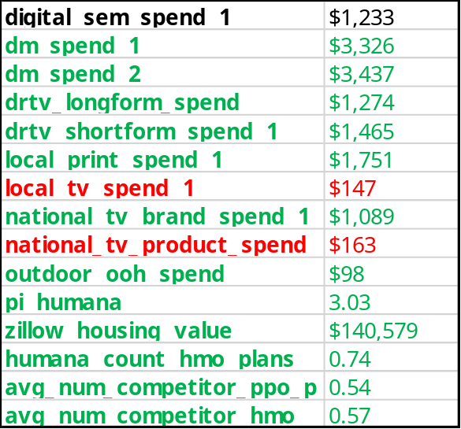
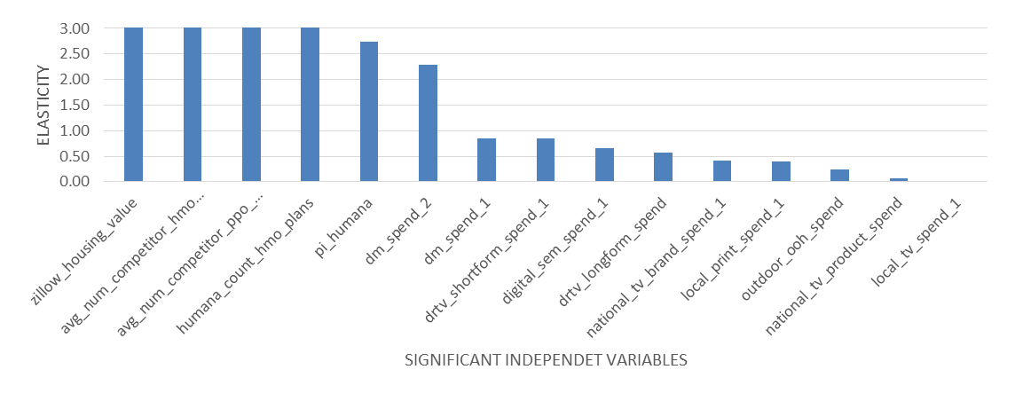
Quadrant1 RESULTS
Overall Adjusted R² 89.60%,
Average Absolute Error 2.93%
Total member count change: mean 10.69, SD 366.86
Significant Variable Mean
The table to the right shows the monthly mean values of significant variables
These are color coded to level of significance
The chart on the bottom shows elasticity ranked by decreasing impact
To interpret, look at dm spend _1
where elasticity = 0.86
this means for every 1% change in spend of dm
there is a resultant impact on
monthly change in count of members lagged 1 month
in the amount of 0.86%
purchase intent
green = most significant, red = least significant
purchase intent

Slide 10
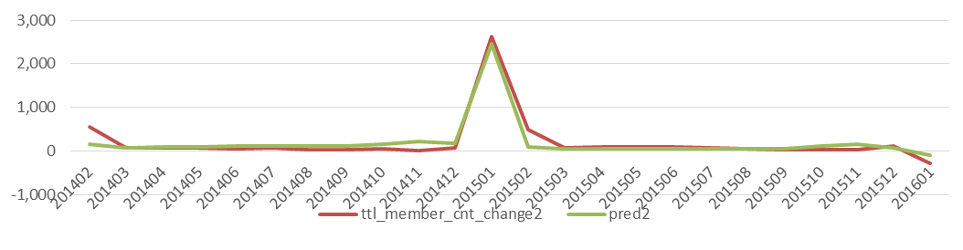
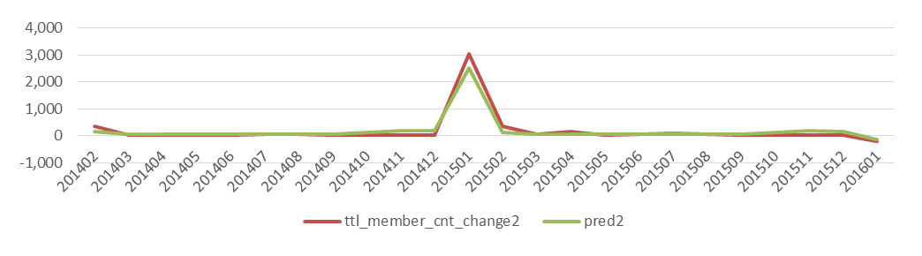
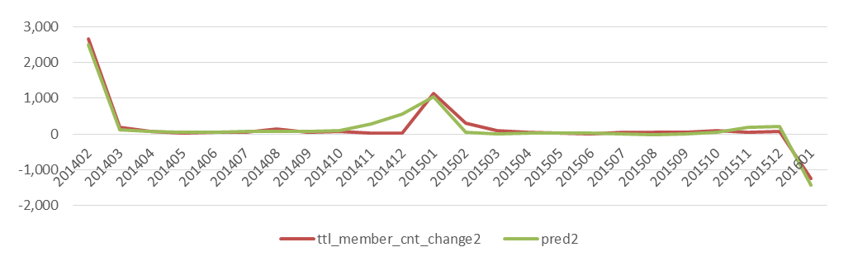
Largest Three Q1 Counties
FIPS 45083
FIPS 18003
FIPS 22033

